Slide 1


Movie Recommendation systems
By: Luca Caruccio
Auri+ Streaming Services

Slide 2
Summary
Business problem
The Data Process
What did we Do and why is it relevant?
What is left to learn?

Slide 3

Business Problem
New Streaming Serivce! Auri+
Oversaturation of Services AND content
How to get new users, and keep them invested and active
Auri+

Slide 4
Data set provided by Movie Lens Measured ratings across Users to compare Filtered results with low average ratings
The Data Process

Slide 5
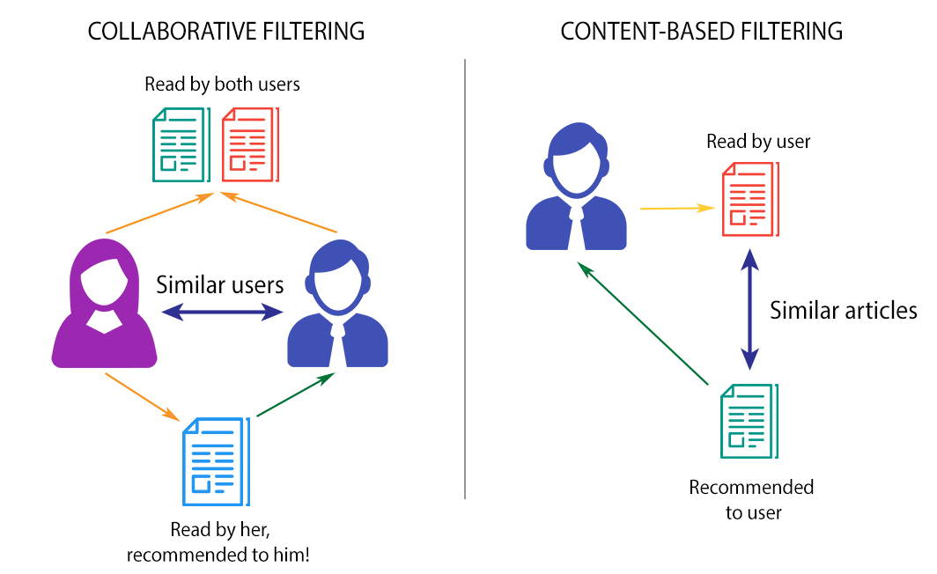
Findings
“Collaborative Filtering Method”
Successfully Recommended relevant movies based on item and other user activity
Created a rating floor as a filter, to ensure higher quality content
.

Slide 6
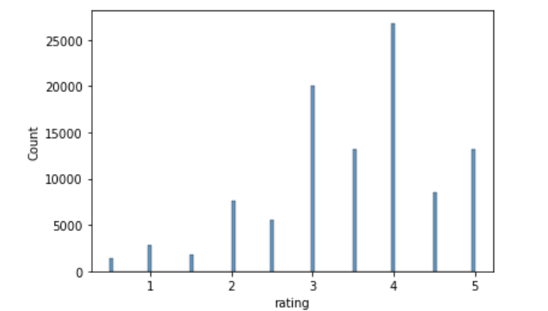
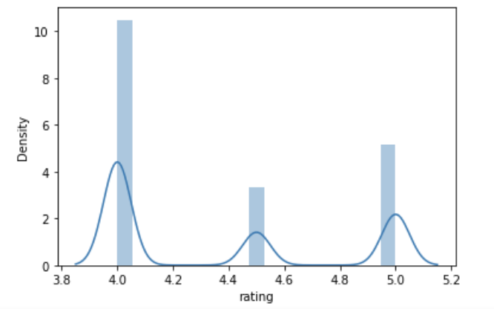
Findings, continued
Average ratings for all movies was 3.5
Filtered movies below that score
Recommendations should be based on Similarity, and Quality
Higher quality movies will promote userbase growth

Slide 7
Recommendations and Future works
Recommendations
Future Work
Include a Recommendation Suggestion on Signup
Use this Recommendation method to issue suggestions for existing users
Incentivized Rating System
Rating Floor for Recommendations
Adding weight to the number of reviews
Filtering by genre for improved accuracy and suggestions

Slide 8

Thank you!
LinkedIn Luca Caruccio
Twitter @lfcaruccio
Email lfcaruccio@gmail.com
Github luca-caruccio

